Slide 1


CPU and Memory Virtualization
06
PART II · HYPERVISORS AND COMPUTE VIRTUALIZATION
CHAPTER 6 · WEEK 5
From Hypervisors to the Cloud-Native Stack
LECTURER
Dr. Mustafa Hameed
THE ISLAMIA UNIVERSITY OF BAHAWALPUR
Bahawalpur, Pakistan
Department of Information Technology · BSIT · Fall 2026
Notes:
Chapter 6: CPU and Memory Virtualization. Part 2 — Hypervisors and Compute Virtualization. Week 5: CPU and memory virtualization. Handout pages 45–52.

Slide 2

Where this chapter sits
THE COURSE
PART I
PART II
PART III
PART IV
PART V
PART VI
1
2
3
4
5
6
7
8
9
10
11
12
13
14
15
16
17
18
19
20
21
22
23
CPU and Memory Virtualization
BUILDS ON
USED LATER IN
Ch 4 Hardware Support for Virtualization
Ch 8 From Virtual Machines to Containers
Ch 5 Major Hypervisor Platforms
Ch 14 Cloud Service and Deployment Models
Ch 15 Desktop and Application Virtualization
Ch 17 High Availability, Live Migration and Disaster Recovery
Ch 18 Performance Monitoring and Capacity Planning
Virtual Systems and Services · Chapter 6 · CPU and Memory Virtualization
Handout p. 45 2
Notes:
Place the chapter. Before you start: Chapter 4 (extended page tables, which are what make guest memory management cheap) and Chapter 5 (the four schedulers). From Operating Systems you need process scheduling and the idea of a working set.

Slide 3

What you will be able to do
LEARNING OUTCOMES
By the end of this chapter you will be able to:
1
Explain how a hypervisor schedules virtual processors onto physical ones, and interpret ready time as the measure of whether it is succeeding.
2
Explain why giving a guest more virtual processors can make it slower, using co-scheduling.
3
Compute CPU and memory overcommit ratios, and decide from measured figures whether a host can take another guest.
4
Order the four memory reclamation techniques by cost and state what each one does to guest performance.
5
Describe NUMA and explain why a guest sized larger than a socket may lose a third of its memory bandwidth.
Virtual Systems and Services · Chapter 6 · CPU and Memory Virtualization
Handout p. 45 3
Notes:
Read these out: they are the chapter's contract with the room. Each click adds one.

Slide 4

Vocabulary for this chapter
KEY TERMS
vCPU
pCPU
time slice
ready time
%RDY
co-scheduling
co-stop
relaxed co-scheduling
overcommit ratio
working set
active memory
transparent page sharing
ballooning
balloon driver
memory compression
hypervisor swapping
memory tax
NUMA
NUMA node
vNUMA
node interleaving
Each term is defined where it first matters — not here.
Virtual Systems and Services · Chapter 6 · CPU and Memory Virtualization
Handout p. 45 4
Notes:
Do not define these now; they arrive one at a time. This slide is for the students' notes. Terms: vCPU; pCPU; time slice; ready time; %RDY; co-scheduling; co-stop; relaxed co-scheduling; overcommit ratio; working set; active memory; transparent page sharing; ballooning; balloon driver; memory compression; hypervisor swapping; memory tax; NUMA; NUMA node; vNUMA; node interleaving.

Slide 5

In this chapter
IN THIS CHAPTER
6.1
Scheduling a Processor That Is Not There
p. 45 ›
6.2
Why More vCPUs Can Be Slower
p. 46 ›
6.3
Memory, and Why It Is the Constraint
p. 47 ›
6.4
NUMA
p. 49 ›
Virtual Systems and Services · Chapter 6 · CPU and Memory Virtualization
Handout pp. 45–52 5
Notes:
The route through the chapter. Each row is a link: click it to jump to that section in the slide show.

Slide 6

Ready Time
DEFINITION
Ready time is the proportion of time a vCPU was runnable but not scheduled — the guest had work, and no physical core was free for it. VMware reports it as %RDY per vCPU; KVM exposes the same quantity as steal time, which the guest itself can see in top as %st.
It is the single most useful number in capacity planning, because it distinguishes the two cases that look identical from inside the guest: a guest that is slow because its own work is slow, and a guest that is slow because it is not being given a processor.
Rules of thumb, widely used and worth knowing: under 5% is healthy, 5–10% deserves investigation, and sustained figures above 10% mean the host is oversubscribed. Chapter 18 treats the measurement properly.
Virtual Systems and Services · Chapter 6 · CPU and Memory Virtualization
§6.1 · Handout p. 45 6
Notes:
A guest configured with four virtual processors believes it has four processors. It runs four run queues, balances threads across them, and spins on locks expecting the other holder to be making progress. None of that is true: a vCPU is a thread the hypervisor schedules onto a pCPU, and between one guest instruction and the next it may have been off the processor for milliseconds. For CPU-bound work this is nearly free — the guest’s instructions run on the real processor at full speed, as Chapter 2 measured. The costs appear when guests contend, and they are measured by one number.

Slide 7
Why More vCPUs Can Be Slower
SECTION 2 OF 4
6.2
6.1 Scheduling a Processor That Is Not There
6.2 Why More vCPUs Can Be Slower
6.3 Memory, and Why It Is the Constraint
6.4 NUMA
Virtual Systems and Services · Chapter 6
Handout §6.2 7
Notes:
Pause. Name the question this section answers.

Slide 8
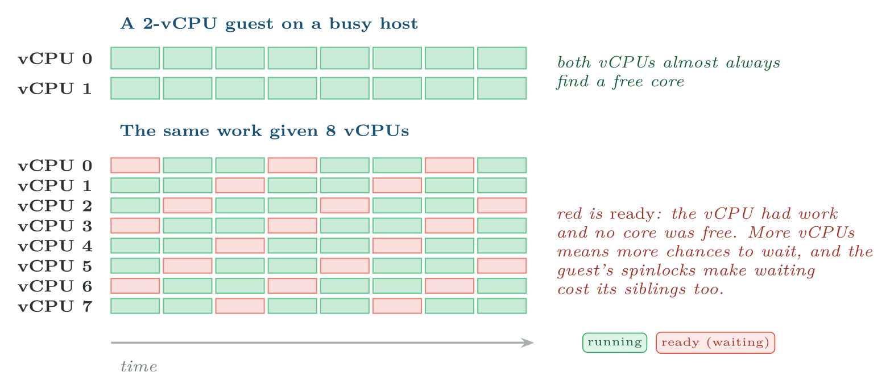
Why a bigger guest can be a slower guest
FIGURE 6.1
Right-sizing downward is the most common successful intervention in a contended cluster, and the one administrators are most reluctant to make.
Virtual Systems and Services · Chapter 6 · CPU and Memory Virtualization
§6.2 · Handout p. 46 8
Notes:
The first instinct on finding a slow guest is to give it more processors. It is often exactly wrong, and the reason is co-scheduling. A guest kernel assumes its processors run simultaneously. A thread holding a spinlock on vCPU 0 will be released shortly, so a thread on vCPU 1 spins rather than sleeping. If vCPU 0 is descheduled while holding that lock, vCPU 1 spins for a whole time slice — burning a physical core to wait for a virtual one that is not running. Early hypervisors avoided this by strict co-scheduling: never run a guest’s vCPUs unless all of them can run together. That removes the problem and creates a worse one — an eight-vCPU guest waits for eight free cores, and on a busy host it waits a long time. Modern schedulers use relaxed co-scheduling: a vCPU is allowed to fall behind its siblings by a small margin, and is forced to catch up only when the skew grows too large. The waiting that results is reported as co-stop.
Figure 6.1 (handout p. 46): Why a bigger guest can be a slower guest. Right-sizing downward is the most common successful intervention in a contended cluster, and the one administrators are most reluctant to make.

Slide 9

The rule that follows: size for what is used, not what is asked for
WATCH OUT
Users ask for vCPUs the way they ask for disk — more is safer. It is not. A guest given eight vCPUs and using two has not merely wasted six; it has made itself harder to schedule, raised its own ready time and raised everyone else’s.
The operational rule is to allocate what measurement justifies and add more when ready time and utilisation both say so. Chapter 18 gives the procedure; the point here is that the arithmetic of overcommit does not capture it, because two guests with the same total vCPU count behave differently according to how those vCPUs are grouped.
Virtual Systems and Services · Chapter 6 · CPU and Memory Virtualization
§6.2 · Handout p. 46 9
Notes:
Read the box aloud, then ask for an example from the room before moving on.

Slide 10
Memory, and Why It Is the Constraint
SECTION 3 OF 4
6.3
6.1 Scheduling a Processor That Is Not There
6.2 Why More vCPUs Can Be Slower
6.3 Memory, and Why It Is the Constraint
6.4 NUMA
Virtual Systems and Services · Chapter 6
Handout §6.3 10
Notes:
Pause. Name the question this section answers.

Slide 11
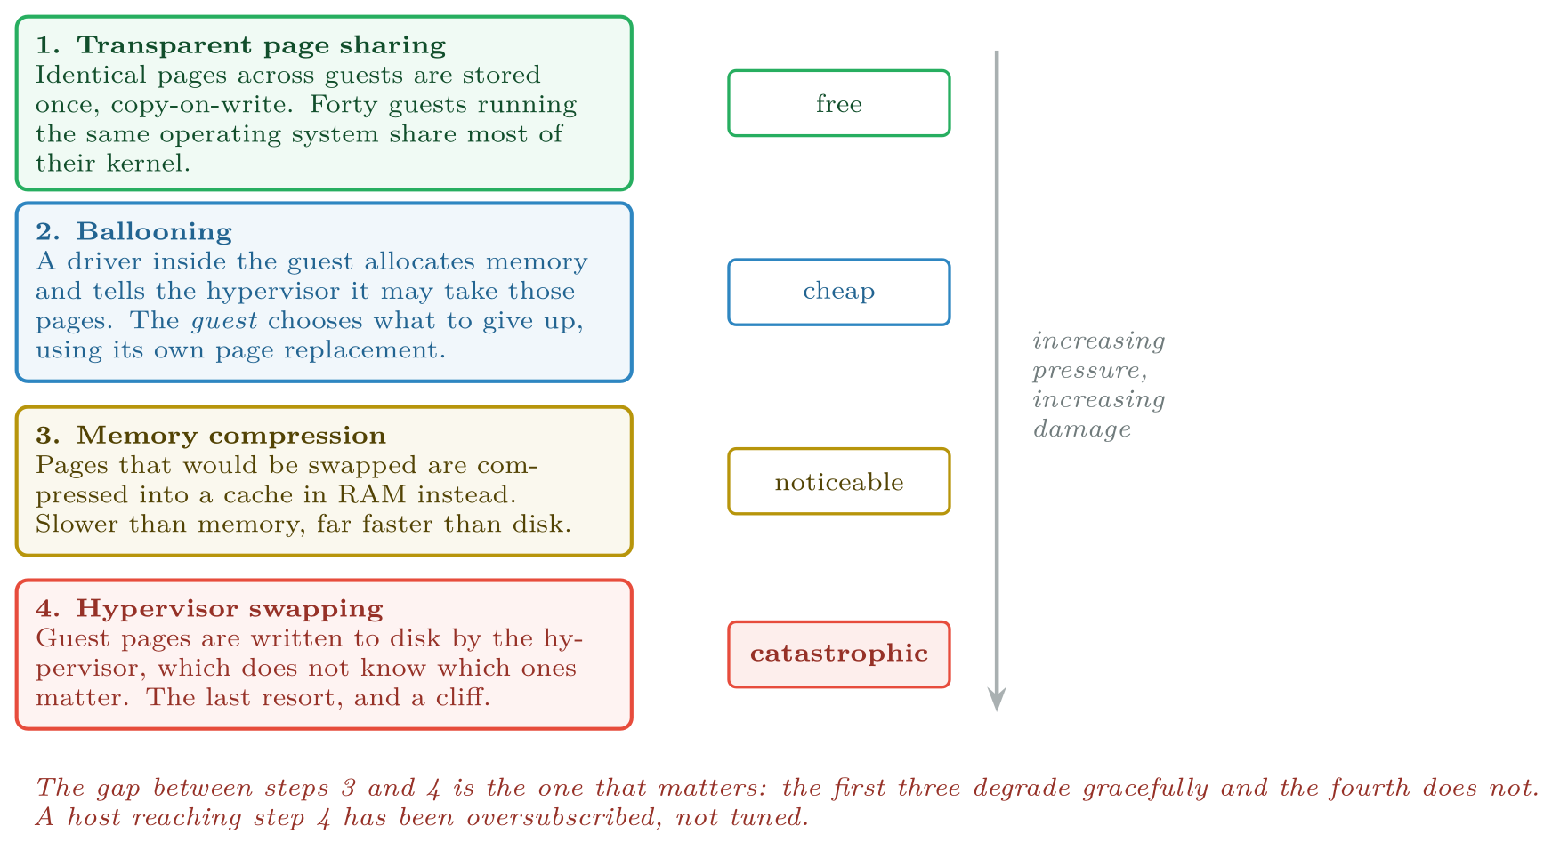
The reclamation ladder
FIGURE 6.2
A hypervisor works down it as pressure rises; an administrator’s job is to ensure it never reaches the bottom rung.
Virtual Systems and Services · Chapter 6 · CPU and Memory Virtualization
§6.3 · Handout p. 47 11
Notes:
Chapter 1 asserted that memory, not processor time, usually decides how many guests fit. The reason is that the two resources are elastic in different ways. A processor can be oversubscribed because time is divisible: two guests each wanting a core can have it alternately, and the result is slower, not wrong. Memory cannot be divided in time. A page either holds a guest’s data or it does not, and a guest denied a page it is using does not slow down slightly — it swaps, and swapping is a hundredfold penalty, not a percentage. So hypervisors oversubscribe memory cautiously, using four techniques of increasing desperation.
Figure 6.2 (handout p. 47): The reclamation ladder. A hypervisor works down it as pressure rises; an administrator’s job is to ensure it never reaches the bottom rung.

Slide 12

Why Ballooning Works, and Why It Feels Wrong
CONCEPT
Ballooning looks like a trick, and students reasonably ask why the hypervisor does not simply take the pages.
Because it does not know which ones to take. From outside, every guest page looks alike; the hypervisor cannot tell a hot database buffer from a page of cache the guest would discard without noticing. Taking the wrong page costs a disk read in the guest, and the hypervisor would be guessing.
The guest kernel, by contrast, has spent decades getting good at exactly this question. So the balloon driver asks the guest for memory in the one language the guest understands — it allocates it, as any program would — and the guest runs its own page replacement to decide what to give up. The hypervisor then takes the pages backing the balloon, which it knows are not in use.
The consequence worth remembering: ballooning requires the guest to cooperate. A guest without the balloon driver installed cannot be reclaimed from gracefully, and pressure on that host goes straight from step 1 to step 3. Installing guest tools is not cosmetic.
Virtual Systems and Services · Chapter 6 · CPU and Memory Virtualization
§6.3 · Handout p. 47 12
Notes:
Read the box aloud, then ask for an example from the room before moving on.

Slide 13

Can This Host Take Four More Guests?
WORKED EXAMPLE
A host of 2 × 32 cores and 512 GB currently runs 28 guests, each configured with 4 vCPUs and 16 GB. Measured over a month: mean %RDY 4%, 95th percentile 9%; mean active memory 6.2 GB per guest. A team asks for four more identical guests. Decide.
Step 1 — CPU overcommit now and after.
Ready time is already at 9% at the 95th percentile, which is the edge of the acceptable band. Raising oversubscription by 14% will not improve it.
Step 2 — memory allocated.
Virtual Systems and Services · Chapter 6 · CPU and Memory Virtualization
§6.3 · Handout p. 47 13
Notes:
Each click adds one step of the working. Ask for the next number before you reveal it.

Slide 14
Can This Host Take Four More Guests? (continued)
WORKED EXAMPLE
The host has 512 GB in total, and the hypervisor itself needs some — call it 6%, about 32 GB, for its own code, the per-guest overhead and the page tables of Chapter 4. So the request allocates 512 GB of 480 GB usable: 32 GB short before a single guest does anything.
Step 3 — memory active. Today the guests actually touch
of 448 GB allocated — 39%. After the change, 32 × 6.2 = 198.4 GB, still far below 480 GB. So on today’s behaviour the memory fits comfortably.
Virtual Systems and Services · Chapter 6 · CPU and Memory Virtualization
§6.3 · Handout p. 47 14
Notes:
Each click adds one step of the working. Ask for the next number before you reveal it.

Slide 15
Can This Host Take Four More Guests? (continued)
WORKED EXAMPLE
Step 4 — which of Steps 2 and 3 should decide? This is the real question, and the answer is: Step 3 for the normal case, Step 2 for the bad one. Overcommitting memory is safe exactly as long as the guests do not all become active together — and the events that make them active together (a patch window, a backup run, a traffic spike, a failover from another host) are correlated by construction.
If all 32 guests touched their full allocation, demand would be 512 GB against 480 GB usable: 32 GB short, about 1 GB per guest to be reclaimed. Page sharing and ballooning would absorb that — rungs 1 and 2 — so the host would not swap. That is survivable.
Step 5 — the recommendation. Refuse the request as stated, and make a counter-offer. The binding problem is CPU, not memory: 9% ready at the 95th percentile is the symptom of a host already at its limit, and σ_{cpu} = 2.0 will make it worse for all 32 guests, not just the new four.
Virtual Systems and Services · Chapter 6 · CPU and Memory Virtualization
§6.3 · Handout p. 47 15
Notes:
Each click adds one step of the working. Ask for the next number before you reveal it.

Slide 16
Can This Host Take Four More Guests? (continued)
WORKED EXAMPLE
The counter-offer is to right-size. If the existing 28 guests are, like most, using two vCPUs of their four, reducing them to 2 vCPUs gives σ_{cpu} = (28 × 2 + 4 × 4)/64 = 72/64 = 1.13 — and the four new guests fit with ready time lower than it is today. Chapter 18 is how you establish whether that premise holds.
Virtual Systems and Services · Chapter 6 · CPU and Memory Virtualization
§6.3 · Handout p. 47 16
Notes:
Each click adds one step of the working. Ask for the next number before you reveal it.

Slide 17
Do not read a memory overcommit ratio without an active figure
WATCH OUT
σ_{mem} = 1.25 tells you almost nothing on its own. If the guests are using a third of what they were given, it is comfortable. If they are using all of it, the host is already swapping.
Allocation is a promise; active memory is a fact. Plan against the fact, size the safety margin against the promise, and know which of the two you are quoting whenever you quote a number.
Virtual Systems and Services · Chapter 6 · CPU and Memory Virtualization
§6.3 · Handout p. 47 17
Notes:
Read the box aloud, then ask for an example from the room before moving on.

Slide 18
NUMA
SECTION 4 OF 4
6.4
6.1 Scheduling a Processor That Is Not There
6.2 Why More vCPUs Can Be Slower
6.3 Memory, and Why It Is the Constraint
6.4 NUMA
Virtual Systems and Services · Chapter 6
Handout §6.4 18
Notes:
Pause. Name the question this section answers.

Slide 19
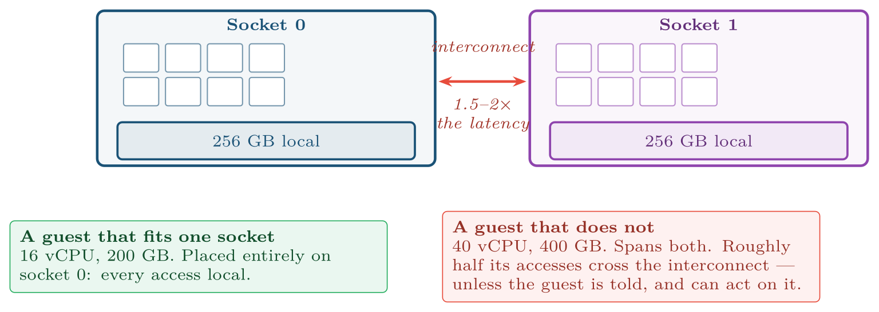
NUMA on a two-socket host
FIGURE 6.3
The green guest is a sizing decision, not a tuning option: once a guest is wider than a socket, no amount of hypervisor configuration makes its memory local again.
Virtual Systems and Services · Chapter 6 · CPU and Memory Virtualization
§6.4 · Handout p. 49 19
Notes:
A two-socket server does not have one pool of memory. Each socket has its own memory controller and its own attached DIMMs; a core reaches its own socket’s memory quickly and the other socket’s memory across an interconnect, more slowly. This is NUMA — non-uniform memory access — and a remote access typically costs something in the region of 1.5 to 2 times a local one in latency, with lower bandwidth.
Figure 6.3 (handout p. 49): NUMA on a two-socket host. The green guest is a sizing decision, not a tuning option: once a guest is wider than a socket, no amount of hypervisor configuration makes its memory local again.

Slide 20
vNUMA: Telling the Guest the Truth
CONCEPT
A guest that must span sockets can still be scheduled well, but only if it knows. vNUMA exposes the host’s NUMA topology to the guest, so the guest kernel’s own NUMA-aware scheduler and allocator can keep each thread’s memory on the node where the thread runs. Databases and JVMs do this competently.
Two consequences follow, and both are commonly missed. First, vNUMA is usually enabled automatically only above a threshold — historically eight or nine vCPUs — so a guest just under it that still spans sockets gets no topology at all. Second, the topology is fixed when the guest boots: migrating it (Chapter 17) to a host with a different socket layout leaves the guest optimising for a machine it is no longer on.
The rule that survives all of this: size guests to fit inside a NUMA node wherever you can. It is the cheapest performance decision in this chapter and it is made at provisioning time, where nobody is looking.
Virtual Systems and Services · Chapter 6 · CPU and Memory Virtualization
§6.4 · Handout p. 49 20
Notes:
Read the box aloud, then ask for an example from the room before moving on.

Slide 21

Common pitfalls
COMMON PITFALLS
✕
Adding vCPUs to a slow guest. If the guest is slow because the host is contended, more vCPUs raise its ready time and everyone else’s. Measure %RDY before changing anything.
✕
Quoting an overcommit ratio with no active-memory figure. Allocation is a promise and activity is a fact; a ratio without the second is not a capacity statement.
✕
Treating the four reclamation techniques as interchangeable. Page sharing is free and ballooning is cheap; swapping is a cliff, not a slope. A host that swaps is misconfigured, not merely busy.
✕
Running guests without the balloon driver and then overcommitting. Without guest cooperation the hypervisor skips the graceful rung entirely.
✕
Ignoring NUMA until there is a problem. It is decided when the guest is sized. A 40-vCPU guest on a 32-core socket cannot be tuned back into locality.
✕
Disabling page sharing because of side-channel advice, without noticing the memory cost. Sharing between guests was restricted by default after 2014 for good reasons, but on a host of forty identical guests it was recovering a substantial fraction of memory. Know which trade you have made.
Virtual Systems and Services · Chapter 6 · CPU and Memory Virtualization
§6.4 · Handout p. 49 21
Notes:
For each pitfall, ask who has seen it happen. One real story beats five bullets.

Slide 22

Try it yourself: Making a Host Hurt, on Purpose
TRY IT YOURSELF
Drives one host into CPU contention and then into memory pressure, and watches each symptom appear. Use a laptop you are not relying on; it will become unresponsive at step 5. Expect forty minutes.
WHAT YOU WILL DO
1. How many physical cores are we actually working with?
2. Build four guests, each with as many vCPUs as the host has.
3. Baseline: one guest busy, three idle.
4. Now make all four busy and read steal time in the guest.
5. Memory pressure: ask for far more than the host has.
6. Right-size, and measure the same thing again.
7. Tear down.
THIS WEEK'S LAB
WHAT YOU WILL RUN
Week 5: Drive a host into contention and read the counters
1 listing, 62 lines of Shell
Virtual Systems and Services · Chapter 6 · CPU and Memory Virtualization
§6.4 · Handout p. 49 22
Notes:
Drives one host into CPU contention and then into memory pressure, and watches each symptom appear. Use a laptop you are not relying on; it will become unresponsive at step 5. Expect forty minutes.

Slide 23
Making a Host Hurt, on Purpose
LAB · STEP 1 OF 8
Set-up
Shell
1
2
3
4
#!/usr/bin/env bash
# ch06_pressure.sh -- ready time and the reclamation ladder, observed.
set -euo pipefail
G () { ssh -o StrictHostKeyChecking=no "ubuntu@$1" "$2"; }
Virtual Systems and Services · Chapter 6 · CPU and Memory Virtualization
§6.4 · Handout p. 49 23
Notes:
Step 1: Set-up. Read the code aloud; ask what each line would print before running it.

Slide 24
Making a Host Hurt, on Purpose
LAB · STEP 2 OF 8
How many physical cores are we actually working with?
Shell
6
7
# --- 1. How many physical cores are we actually working with? ----------
nproc ; lscpu | grep -E 'Socket|Core|NUMA'
Virtual Systems and Services · Chapter 6 · CPU and Memory Virtualization
§6.4 · Handout p. 49 24
Notes:
Step 2: How many physical cores are we actually working with?. Read the code aloud; ask what each line would print before running it.

Slide 25
Making a Host Hurt, on Purpose
LAB · STEP 3 OF 8
Build four guests, each with as many vCPUs as the host has.
Shell
9
10
11
12
13
14
15
16
17
18
19
# --- 2. Build four guests, each with as many vCPUs as the host has. ----
# Deliberate oversubscription: 4 guests x nproc vCPUs on nproc cores.
for n in 1 2 3 4; do
sudo qemu-img create -f qcow2 -b /var/lib/libvirt/images/vss1.qcow2 \
-F qcow2 "/var/lib/libvirt/images/p$n.qcow2" 10G
sudo virt-install --name "p$n" --memory 2048 --vcpus "$(nproc)" \
--disk "/var/lib/libvirt/images/p$n.qcow2",format=qcow2 \
--disk seed.iso,device=cdrom --os-variant ubuntu22.04 \
--import --graphics none --noautoconsole
done
sleep 40
Virtual Systems and Services · Chapter 6 · CPU and Memory Virtualization
§6.4 · Handout p. 49 25
Notes:
Step 3: Build four guests, each with as many vCPUs as the host has.. Read the code aloud; ask what each line would print before running it.

Slide 26
Making a Host Hurt, on Purpose
LAB · STEP 4 OF 8
Baseline: one guest busy, three idle.
Shell
21
22
23
24
25
26
27
# --- 3. Baseline: one guest busy, three idle. --------------------------
ip_of () {
sudo virsh domifaddr "$1" | awk '/ipv4/{split($4,a,"/"); print a[1]}'
}
IP1=$(ip_of p1)
G "$IP1" "sudo apt-get -qq install -y stress-ng sysstat"
G "$IP1" "stress-ng --cpu \$(nproc) --timeout 30s --metrics-brief"
Virtual Systems and Services · Chapter 6 · CPU and Memory Virtualization
§6.4 · Handout p. 49 26
Notes:
Step 4: Baseline: one guest busy, three idle.. Read the code aloud; ask what each line would print before running it.

Slide 27
Making a Host Hurt, on Purpose
LAB · STEP 5 OF 8
Now make all four busy and read steal time in the guest.
Shell
29
30
31
32
33
34
35
36
37
# --- 4. Now make all four busy and read steal time in the guest. -------
# %st in the guest IS the ready time of section 6.1, seen from inside.
for n in 2 3 4; do
IP=$(ip_of "p$n")
G "$IP" "sudo apt-get -qq install -y stress-ng" || true
G "$IP" "nohup stress-ng --cpu \$(nproc) --timeout 60s >/dev/null 2>&1 &"
done
sleep 5
G "$IP1" "mpstat 2 5 | tail -4" # watch the %steal column climb
Virtual Systems and Services · Chapter 6 · CPU and Memory Virtualization
§6.4 · Handout p. 49 27
Notes:
Step 5: Now make all four busy and read steal time in the guest.. Read the code aloud; ask what each line would print before running it.

Slide 28
Making a Host Hurt, on Purpose
LAB · STEP 6 OF 8
Memory pressure: ask for far more than the host has.
Shell
39
40
41
42
43
44
45
46
47
48
# --- 5. Memory pressure: ask for far more than the host has. -----------
# Watch the balloon move before anything swaps.
sudo virsh dommemstat p1
for n in 1 2 3 4; do
G "$(ip_of "p$n")" "nohup stress-ng --vm 1 --vm-bytes 85% \
--timeout 60s >/dev/null 2>&1 &" || true
done
sleep 20
sudo virsh dommemstat p1 # balloon / swap_in / swap_out
free -m ; vmstat 2 4 # the host's own view
Virtual Systems and Services · Chapter 6 · CPU and Memory Virtualization
§6.4 · Handout p. 49 28
Notes:
Step 6: Memory pressure: ask for far more than the host has.. Read the code aloud; ask what each line would print before running it.

Slide 29
Making a Host Hurt, on Purpose
LAB · STEP 7 OF 8
Right-size, and measure the same thing again.
Shell
50
51
52
53
54
55
56
# --- 6. Right-size, and measure the same thing again. ------------------
# Two vCPUs each instead of nproc: the overcommit ratio drops fourfold.
for n in 1 2 3 4; do sudo virsh destroy "p$n"; \
sudo virsh setvcpus "p$n" 2 --config --maximum --config; \
sudo virsh setvcpus "p$n" 2 --config; sudo virsh start "p$n"; done
sleep 40
G "$IP1" "mpstat 2 5 | tail -4" # %steal should be far lower
Virtual Systems and Services · Chapter 6 · CPU and Memory Virtualization
§6.4 · Handout p. 49 29
Notes:
Step 7: Right-size, and measure the same thing again.. Read the code aloud; ask what each line would print before running it.

Slide 30
Making a Host Hurt, on Purpose
LAB · STEP 8 OF 8
Tear down.
Shell
58
59
60
61
62
# --- 7. Tear down. -----------------------------------------------------
for n in 1 2 3 4; do
sudo virsh destroy "p$n" || true
sudo virsh undefine "p$n" --remove-all-storage || true
done
Virtual Systems and Services · Chapter 6 · CPU and Memory Virtualization
§6.4 · Handout p. 49 30
Notes:
Step 8: Tear down.. Read the code aloud; ask what each line would print before running it.

Slide 31
What the lab shows
TRY IT YOURSELF
What to notice. Step 4’s %steal is the worked example’s %RDY, measured from inside the guest, and step 6 shows that halving the vCPU count made every guest faster. That is the chapter’s least intuitive claim and you have now produced it yourself.
Virtual Systems and Services · Chapter 6 · CPU and Memory Virtualization
§6.4 · Handout p. 49 31
Notes:
Read the box aloud, then ask for an example from the room before moving on.

Slide 32

A host of 48 cores runs 20 guests of 6 vCPUs each. Give the CPU overcommit ratio. Mean %RDY is 14%. State what you would do and what you would measure first.
CHECKPOINT 1 OF 3
Discuss with the person next to you, then advance.
Virtual Systems and Services · Chapter 6 · CPU and Memory Virtualization
Handout p. 52 · answers in Appendix D 32
Notes:
Ask the room. Do not advance until someone commits to an answer.

Slide 33

A host of 48 cores runs 20 guests of 6 vCPUs each. Give the CPU overcommit ratio. Mean %RDY is 14%. State what you would do and what you would measure first.
CHECKPOINT 1 OF 3 · ANSWER
σ_{cpu} = (20 × 6)/48 = 120/48 = 2.5. A mean %RDY of 14% is well above the 10% action threshold, so the host is oversubscribed. Measure first: the actual vCPU utilisation of each guest — 6 vCPUs is a large allocation and is very likely more than most of them use. Then act: right-size downward before buying anything. Halving the allocations would bring σ to 1.25 and would almost certainly resolve the ready time without new hardware.
Virtual Systems and Services · Chapter 6 · CPU and Memory Virtualization
Handout p. 52 · answers in Appendix D 33
Notes:
Answer (Appendix D): σcpu = (20 × 6)/48 = 120/48 = 2.5. A mean %RDY of 14% is well above the 10% action threshold, so the host is oversubscribed. Measure first: the actual vCPU utilisation of each guest — 6 vCPUs is a large allocation and is very likely more than most of them use. Then act: right-size downward before buying anything. Halving the allocations would bring σ to 1.25 and would almost certainly resolve the ready time without new hardware.

Slide 34
Explain why the hypervisor asks the guest to give up memory through a balloon driver rather than simply reclaiming pages itself.
CHECKPOINT 2 OF 3
Discuss with the person next to you, then advance.
Virtual Systems and Services · Chapter 6 · CPU and Memory Virtualization
Handout p. 52 · answers in Appendix D 34
Notes:
Ask the room. Do not advance until someone commits to an answer.

Slide 35
Explain why the hypervisor asks the guest to give up memory through a balloon driver rather than simply reclaiming pages itself.
CHECKPOINT 2 OF 3 · ANSWER
Because the hypervisor cannot tell which pages matter. From outside, every guest page looks alike; it cannot distinguish a hot database buffer from a page of cache the guest would discard without noticing, so taking pages itself means guessing, and a wrong guess costs the guest a disk read. The guest kernel has a page-replacement algorithm that is good at exactly this question. The balloon driver asks in the one language the guest understands — it allocates memory — and the guest decides what to give up.
Virtual Systems and Services · Chapter 6 · CPU and Memory Virtualization
Handout p. 52 · answers in Appendix D 35
Notes:
Answer (Appendix D): Because the hypervisor cannot tell which pages matter. From outside, every guest page looks alike; it cannot distinguish a hot database buffer from a page of cache the guest would discard without noticing, so taking pages itself means guessing, and a wrong guess costs the guest a disk read. The guest kernel has a page-replacement algorithm that is good at exactly this question. The balloon driver asks in the one language the guest understands — it allocates memory — and the guest decides what to give up.

Slide 36
A guest is configured with 40 vCPUs and 400 GB on a host with two 32-core sockets and 256 GB per socket. Name the problem, say why no hypervisor setting fixes it, and give the one change that would.
CHECKPOINT 3 OF 3
Discuss with the person next to you, then advance.
Virtual Systems and Services · Chapter 6 · CPU and Memory Virtualization
Handout p. 52 · answers in Appendix D 36
Notes:
Ask the room. Do not advance until someone commits to an answer.

Slide 37
A guest is configured with 40 vCPUs and 400 GB on a host with two 32-core sockets and 256 GB per socket. Name the problem, say why no hypervisor setting fixes it, and give the one change that would.
CHECKPOINT 3 OF 3 · ANSWER
The guest is wider than a NUMA node. It has 40 vCPUs against 32 cores per socket and 400 GB against 256 GB per socket, so it must span both sockets and roughly half its memory accesses cross the interconnect at 1.5–2× the latency. No hypervisor setting fixes it because the memory is physically attached to a socket; locality cannot be created after the fact. The change that would work is resizing the guest to fit inside one node — 32 vCPU and 256 GB or less. Failing that, enable vNUMA so the guest’s own scheduler can at least keep each thread’s memory on its own node.
Virtual Systems and Services · Chapter 6 · CPU and Memory Virtualization
Handout p. 52 · answers in Appendix D 37
Notes:
Answer (Appendix D): The guest is wider than a NUMA node. It has 40 vCPUs against 32 cores per socket and 400 GB against 256 GB per socket, so it must span both sockets and roughly half its memory accesses cross the interconnect at 1.5–2× the latency. No hypervisor setting fixes it because the memory is physically attached to a socket; locality cannot be created after the fact. The change that would work is resizing the guest to fit inside one node — 32 vCPU and 256 GB or less. Failing that, enable vNUMA so the guest’s own scheduler can at least keep each thread’s memory on its own node.

Slide 38

What to take away
CHAPTER SUMMARY
1
A vCPU is a thread scheduled onto a physical core. Ready time — %RDY, or steal time inside the guest — measures how often it had work and no core. Under 5% healthy, over 10% oversubscribed.
2
More vCPUs can make a guest slower: a guest’s spinlocks assume its processors run together, and relaxed co-scheduling makes a wide guest wait. Right-sizing downward is the commonest effective fix.
3
Processor time is divisible and memory is not, which is why memory usually decides guest density.
4
The reclamation ladder: page sharing (free), ballooning (cheap, needs the guest driver), compression (noticeable), hypervisor swapping (a cliff). The job is to never reach the fourth.
5
Overcommit ratios mean nothing without an active-memory figure. Allocation is a promise; activity is a fact.
6
NUMA is decided at provisioning time. Size guests inside a node where you can; where you cannot, make sure vNUMA tells the guest the truth.
Virtual Systems and Services · Chapter 6 · CPU and Memory Virtualization
Handout p. 52 38
Notes:
Ask the room to say each takeaway before you reveal it.

Slide 39

Quick check 1 of 2
REVIEW · MULTIPLE CHOICE
Ready time measures:
the fraction of time a vCPU was runnable but not scheduled
A
how long the guest took to boot
B
C
the hypervisor’s own CPU use
D
time spent in VM exits
Virtual Systems and Services · Chapter 6 · CPU and Memory Virtualization
Handout p. 52 39
Notes:
Take a show of hands for each option before discussing. (The handout does not print MCQ answers.)

Slide 40
Quick check 2 of 2
REVIEW · MULTIPLE CHOICE
Ballooning requires:
A
extended page tables
B
an IOMMU
C
a cooperating driver inside the guest
D
shared storage
Virtual Systems and Services · Chapter 6 · CPU and Memory Virtualization
Handout p. 52 40
Notes:
Take a show of hands for each option before discussing. (The handout does not print MCQ answers.)

Slide 41
For your notebook
REVIEW QUESTIONS
SHORT
Explain co-scheduling and why relaxed co-scheduling replaced the strict form.
SHORT
Give the four reclamation techniques in order and say what each costs the guest.
SHORT
Why is a memory overcommit ratio of 1.3 potentially safe while a CPU overcommit ratio of 1.3 is almost always safe?
APPLIED
A host of 2 × 24 cores and 384 GB runs 30 guests of 4 vCPUs and 12 GB. Measured: %RDY mean 7%, p95 15%; active memory 4.1 GB per guest. A team wants six more identical guests. Work through the same five steps as the chapter’s worked example and give a recommendation with a counter-offer.
APPLIED
A database guest is reported as slow. It has 32 vCPUs and 512 GB on a two-socket host with 24 cores and 384 GB per socket. List what you would measure, in order, and for each possible finding say what you would change.
Virtual Systems and Services · Chapter 6 · CPU and Memory Virtualization
Handout p. 52 41
Notes:
Set these for independent study. Model answers are not printed in the handout.

Slide 42
End of Chapter 6
06
NEXT
READ
Chapter 7 — Paravirtualization and Device Virtualization
Handout Chapter 6, pages 45–52
THIS WEEK'S LAB
Drive a host into contention and read the counters
Virtual Systems and Services · Chapter 6 · CPU and Memory Virtualization
42
Notes:
Close. NEXT: Chapter 7 — Paravirtualization and Device Virtualization. READ: Handout Chapter 6, pages 45–52. THIS WEEK'S LAB: Drive a host into contention and read the counters.

